Slide 1
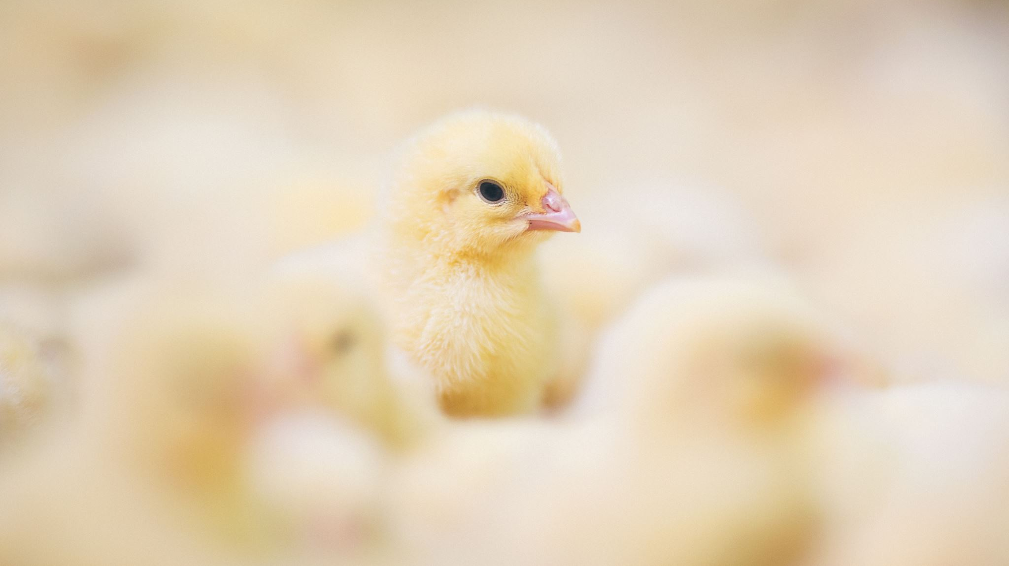

Livestock Migration across the United Kingdom
Toluwase Idowu

Slide 2
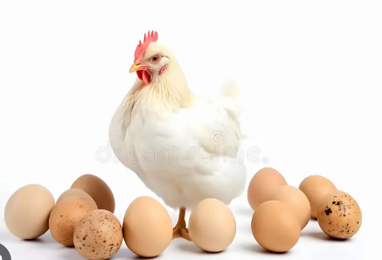
Introduction
Just like humans, the migrations of Livestock from one place to another is a popular culture across the world. The United Kingdom is not an exception to this practice and in other to give proper structure and supervision to the migration of animals across the United Kingdom the Animal and Plant Health Agency is given the overseeing authority to ensure these movements are not only recorded but done in the right manner.

Slide 3
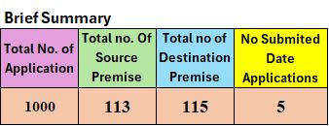

Data Preparation
The initial step was to prepare the data to ensure its usability. I verified the provided data against the following criteria:
• Completeness
• Velocity
• Variety
• Volume
Please take note: The Source AIV Number, Destination AIV Number, Source Premise Local Authority, and Destination Premise Local Authority columns contain missing data.

Slide 4
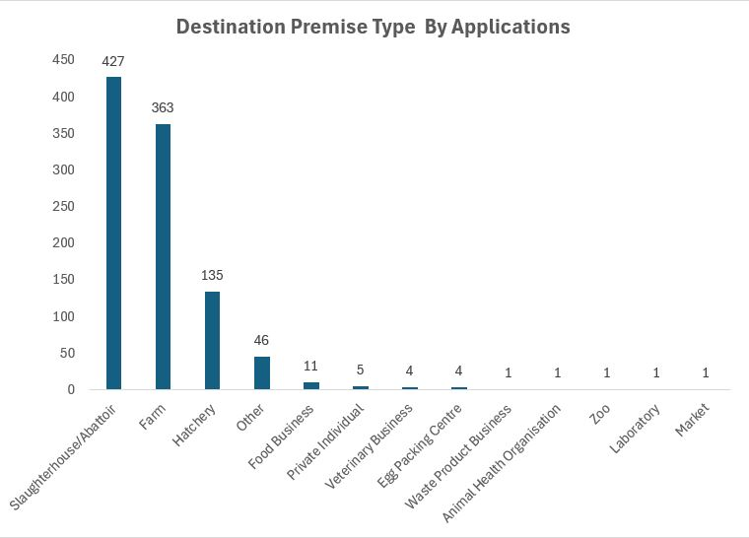
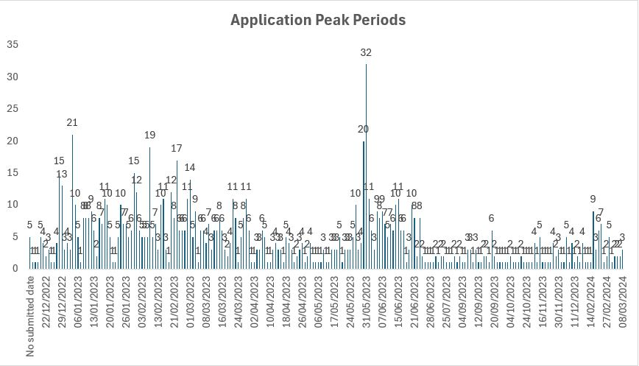
Destination Premise Graph and Movement Trends

Slide 5
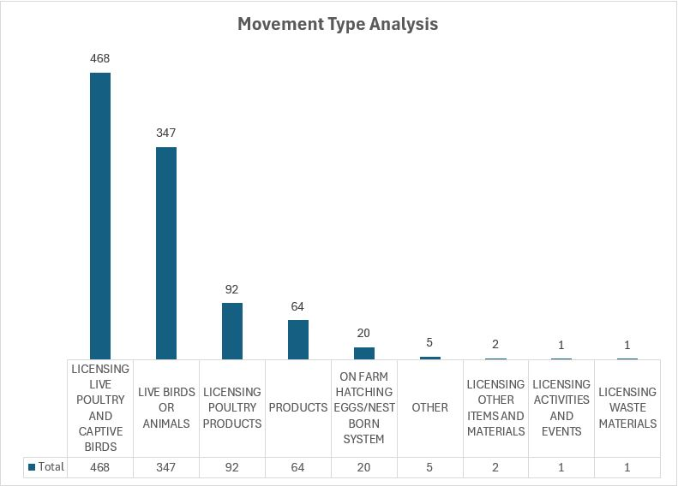
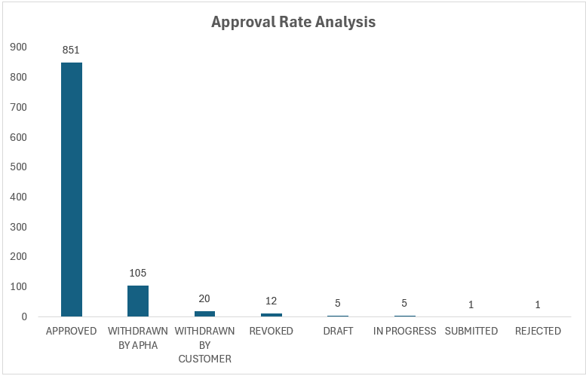
Data Analysis / Visualization

Slide 6
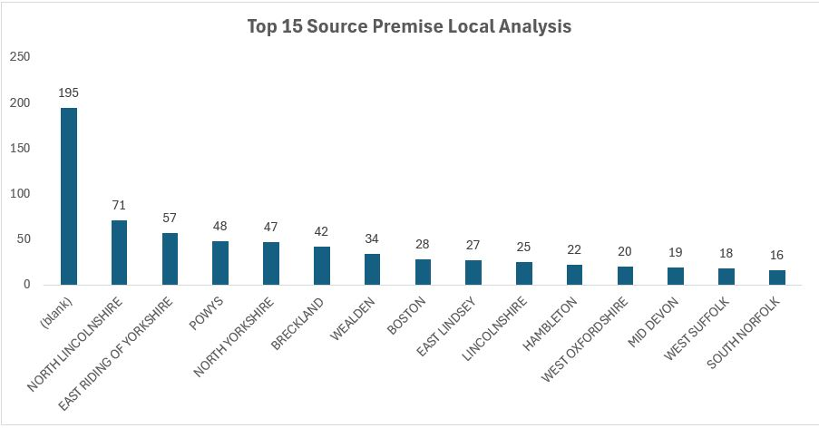
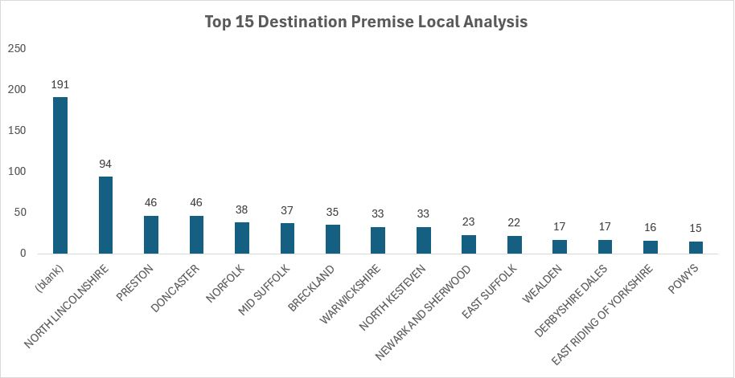
Source and Destination Premise Analysis

Slide 7
Recommendations
Investigate the source of data collection to reduce missing data.
Explore the earliest movement column to see how it affects customer satisfaction.
Investigate reason for withdrawals of applications.
Conduct a Geospatial Analysis to see the distribution of movement of animals across the United Kingdom.
Investigate the movement trend against climate/weather change.
Investigate the average time it takes to get an approval thereby providing the customer with an expected date of approval at the point of application.

Slide 8

Questions

